Slide 1


Balasubramanian Pandian
24/07/2025

Slide 2

Outline
Executive Summary
Introduction
Methodology
Results
Conclusion
Appendix

Slide 3

Executive Summary
Collected data from public SpaceX API and SpaceX Wikipedia page. Created labels column ‘class’ which classifies successful landings. Explored data using SQL, visualization, folium maps, and dashboards. Gathered relevant columns to be used as features. Changed all categorical variables to binary using one hot encoding. Standardized data and used GridSearchCV to find best parameters for machine learning models. Visualize accuracy score of all models.
Four machine learning models were produced: Logistic Regression, Support Vector Machine, Decision Tree Classifier, and K Nearest Neighbors. All produced similar results with accuracy rate of about 83.33%. All models over predicted successful landings. More data is needed for better model determination and accuracy.
Summary of methodologies
Summary of all results

Slide 4
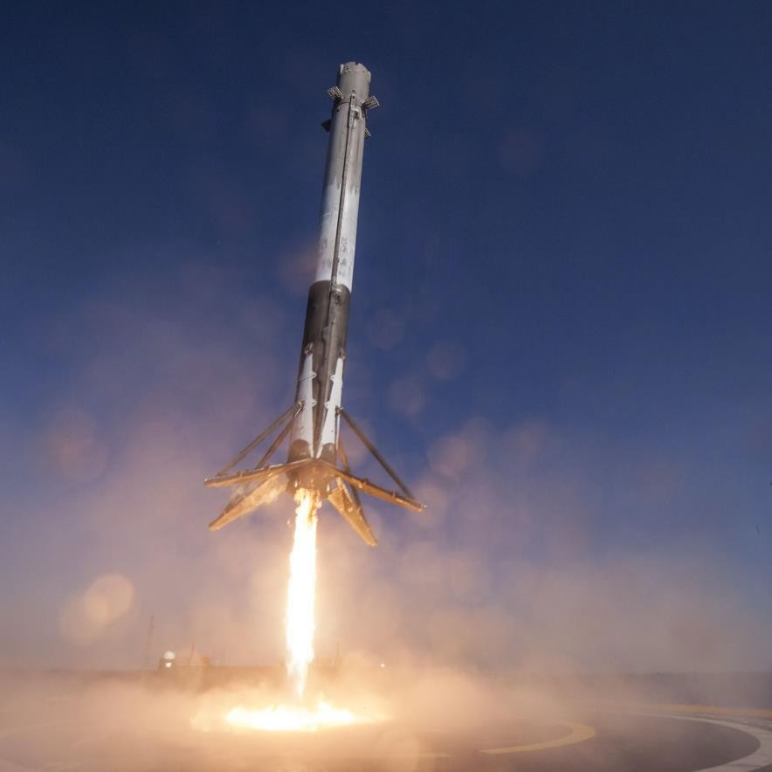
Introduction
Project background and context
Commercial Space Age is Here
Space X has best pricing ($62 million vs. $165 million USD)
Largely due to ability to recover part of rocket (Stage 1)
Space Y wants to compete with Space X
Problems you want to find answers
Space Y tasks us to train a machine learning model to predict successful Stage 1 recovery
SpaceX Falcon 9 Rocket – The Verge

Slide 5

Section 1

Slide 6
Methodology
Executive Summary
Data collection methodology:
Describe how data was collected
Perform data wrangling
Describe how data was processed
Perform exploratory data analysis (EDA) using visualization and SQL
Perform interactive visual analytics using Folium and Plotly Dash
Perform predictive analysis using classification models
How to build, tune, evaluate classification models

Slide 7
Data Collection
Describe how data sets were collected.
You need to present your data collection process use key phrases and flowcharts
Data collection process involved a combination of API requests from Space X public API and web scraping data from a table in Space X’s Wikipedia entry.
The next slide will show the flowchart of data collection from API and the one after will show the flowchart of data collection from webscraping.
Space X API Data Columns:
FlightNumber, Date, BoosterVersion, PayloadMass, Orbit, LaunchSite, Outcome, Flights, GridFins,
Reused, Legs, LandingPad, Block, ReusedCount, Serial, Longitude, Latitude
Wikipedia Webscrape Data Columns:
Flight No., Launch site, Payload, PayloadMass, Orbit, Customer, Launch outcome, Version Booster, Booster landing, Date, Time

Slide 8
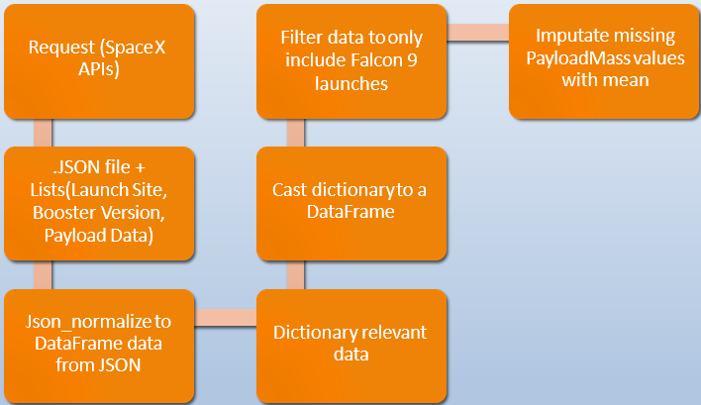
Data Collection – SpaceX API
Present your data collection with SpaceX REST calls using key phrases and flowcharts
Add the GitHub URL of the completed SpaceX API calls notebook (must include completed code cell and outcome cell), as an external reference and peer-review purpose
GitHub url: https://github.com/Balasubramanian1981/Dheesha/blob/main/SpaceX%20Falcon%209%20first%20stage%20Landing%20Prediction.ipynb
Place your flowchart of SpaceX API calls here

Slide 9
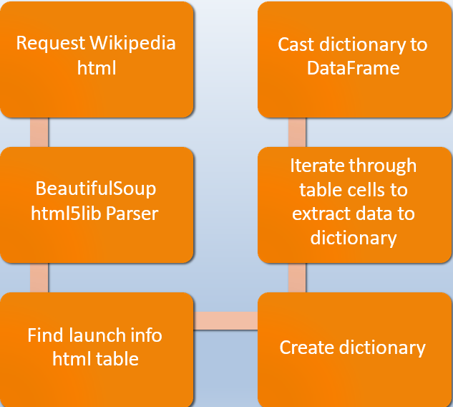
Data Collection - Scraping
Present your web scraping process using key phrases and flowcharts
Add the GitHub URL of the completed web scraping notebook, as an external reference and peer-review purpose
GitHub url: https://github.com/Balasubramanian1981/Dheesha/blob/main/Space%20X%20Falcon%209%20First%20Stage%20Landing%20Prediction.ipynb
Place your flowchart of web scraping here

Slide 10
Data Wrangling
Describe how data were processed
Create a training label with landing outcomes where successful = 1 & failure = 0.
Outcome column has two components: ‘Mission Outcome’ ‘Landing Location’
New training label column ‘class’ with a value of 1 if ‘Mission Outcome’ is True and 0 otherwise. Value Mapping:
True ASDS, True RTLS, & True Ocean – set to -> 1
None None, False ASDS, None ASDS, False Ocean, False RTLS – set to -> 0
You need to present your data wrangling process using key phrases and flowcharts
Add the GitHub URL of your completed data wrangling related notebooks, as an external reference and peer-review purpose
GitHub url:
https://github.com/Balasubramanian1981/Dheesha/blob/main/Space%20X%20Falcon%209%20First%20Stage%20Landing%20Prediction-Data%20wrangling.ipynb

Slide 11
EDA with Data Visualization
Summarize what charts were plotted and why you used those charts
Exploratory Data Analysis performed on variables Flight Number, Payload Mass, Launch Site, Orbit, Class and Year.
Add the GitHub URL of your completed EDA with data visualization notebook, as an external reference and peer-review purpose
Plots Used:
Flight Number vs. Payload Mass, Flight Number vs. Launch Site, Payload Mass vs. Launch Site, Orbit vs. Success Rate, Flight Number vs. Orbit, Payload vs Orbit, and Success Yearly Trend
Scatter plots, line charts, and bar plots were used to compare relationships between variables to
decide if a relationship exists so that they could be used in training the machine learning model
GitHub url:
https://github.com/Balasubramanian1981/Dheesha/blob/main/EDA%20with%20Visualization.ipynb

Slide 12
EDA with SQL
Using bullet point format, summarize the SQL queries you performed
Add the GitHub URL of your completed EDA with SQL notebook, as an external reference and peer-review purpose
Loaded data set into IBM DB2 Database.
Queried using SQL Python integration.
Queries were made to get a better understanding of the dataset.
Queried information about launch site names, mission outcomes, various pay load sizes of customers and booster versions, and landing outcomes

Slide 13
Build an Interactive Map with Folium
Summarize what map objects such as markers, circles, lines, etc. you created and added to a folium map
Explain why you added those objects
Add the GitHub URL of your completed interactive map with Folium map, as an external reference and peer-review purpose
Folium maps mark Launch Sites, successful and unsuccessful landings, and a proximity example to key locations: Railway, Highway, Coast, and City.
This allows us to understand why launch sites may be located where they are. Also visualizes successful landings relative to location.
GitHub url:
https://github.com/Balasubramanian1981/Dheesha/blob/main/Interactive%20Visual%20Analytics%20with%20Folium.ipynb

Slide 14
Build a Dashboard with Plotly Dash
Summarize what plots/graphs and interactions you have added to a dashboard
Explain why you added those plots and interactions
Add the GitHub URL of your completed Plotly Dash lab, as an external reference and peer-review purpose
Dashboard includes a pie chart and a scatter plot.
Pie chart can be selected to show distribution of successful landings across all launch sites and can be selected to show individual launch site success rates.
Scatter plot takes two inputs: All sites or individual site and payload mass on a slider between 0 and 10000 kg.
The pie chart is used to visualize launch site success rate.
The scatter plot can help us see how success varies across launch sites, payload mass, and
booster version category.

Slide 15
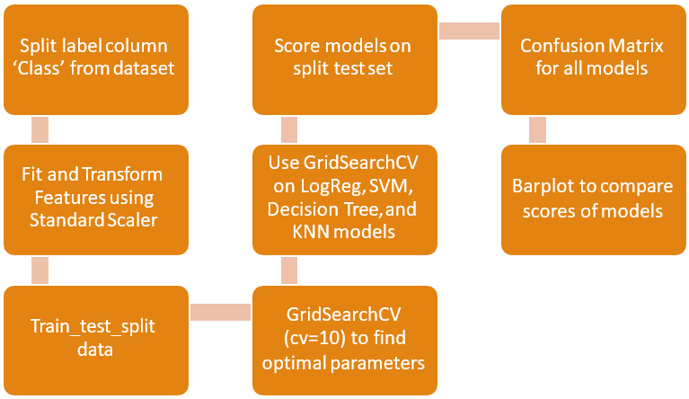
Predictive Analysis (Classification)
Summarize how you built, evaluated, improved, and found the best performing classification model
You need present your model development process using key phrases and flowchart
Add the GitHub URL of your completed predictive analysis lab, as an external reference and peer-review purpose

Slide 16
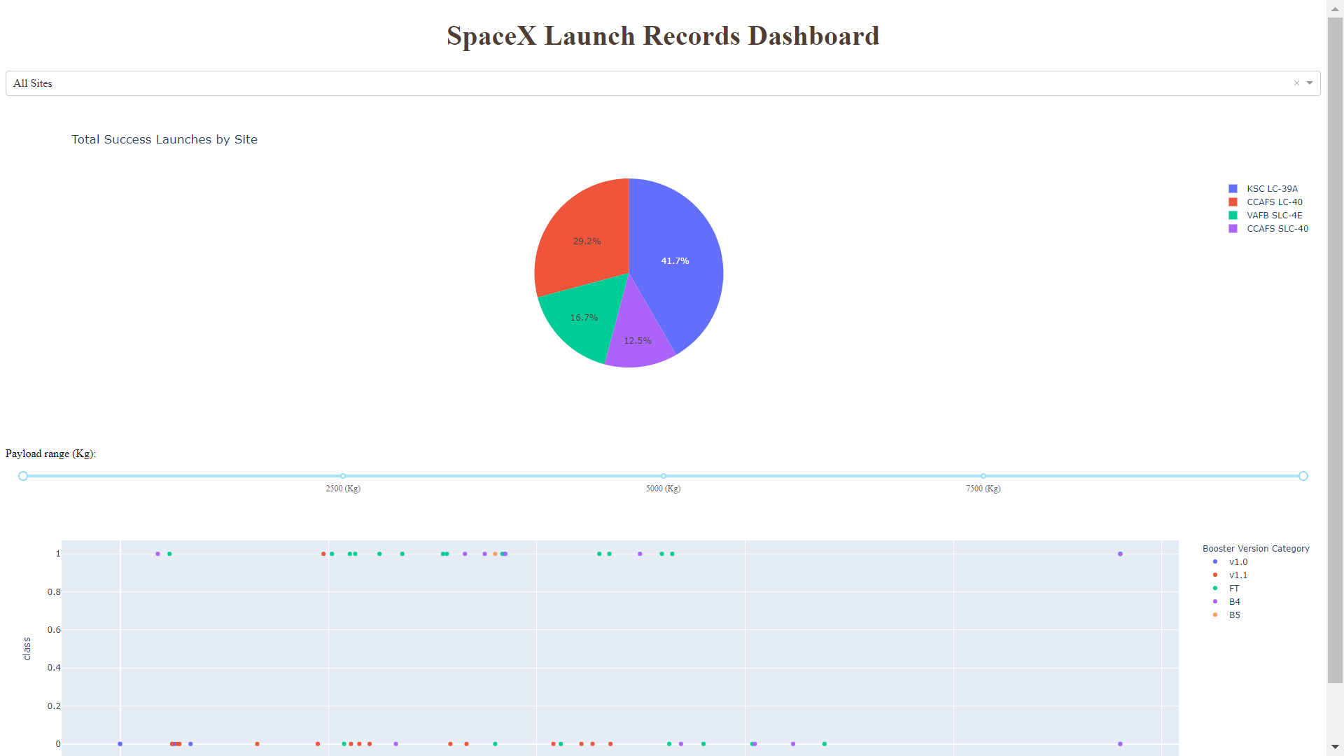
Results
Exploratory data analysis results
Interactive analytics demo in screenshots
Predictive analysis results
This is a preview of the Plotly dashboard. The following sides will show the results of EDA with visualization, EDA with SQL, Interactive Map with Folium, and finally the results of our model with about 83% accuracy.

Slide 17

Section 2

Slide 18
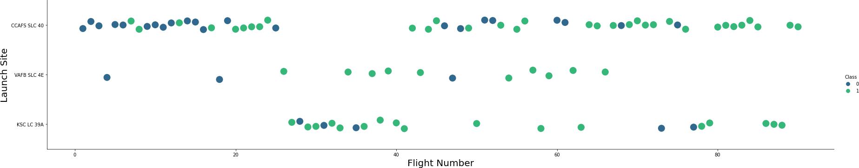
Flight Number vs. Launch Site
Show a scatter plot of Flight Number vs. Launch Site
Show the screenshot of the scatter plot with explanations
Graphic suggests an increase in success rate over time (indicated in Flight Number). Likely a big breakthrough around flight 20 which significantly increased success rate. CCAFS appears to be the main launch site as it has the most volume.

Slide 19
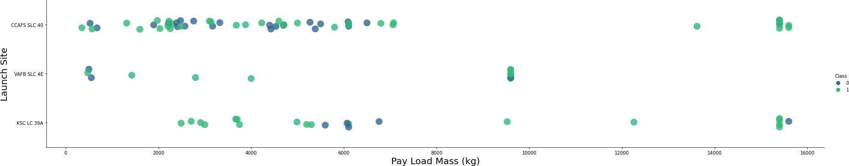
Payload vs. Launch Site
Show a scatter plot of Payload vs. Launch Site
Show the screenshot of the scatter plot with explanations
Green indicates successful launch; Purple indicates unsuccessful launch.
Payload mass appears to fall mostly between 0-6000 kg. Different launch sites also seem to use different payload mass.

Slide 20
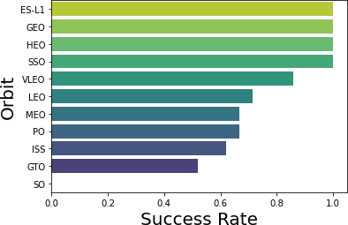
Success Rate vs. Orbit Type
Show a bar chart for the success rate of each orbit typeShow the screenshot of the scatter plot with explanations
ES-L1 (1), GEO (1), HEO (1) have 100% success rate (sample sizes in parenthesis) SSO (5) has 100% success rate
VLEO (14) has decent success rate and attempts
SO (1) has 0% success rate
GTO (27) has the around 50% success rate but largest sample
Success Rate Scale with 0 as 0%
0.6 as 60% 1 as 100%

Slide 21
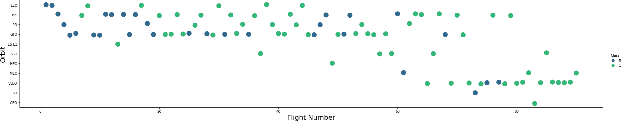
Flight Number vs. Orbit Type
Show a scatter point of Flight number vs. Orbit typeShow the screenshot of the scatter plot with explanations
Green indicates successful launch; Purple indicates unsuccessful launch.
Launch Orbit preferences changed over Flight Number. Launch Outcome seems to correlate with this preference.
SpaceX started with LEO orbits which saw moderate success LEO and returned to VLEO in recent launches SpaceX appears to perform better in lower orbits or Sun-synchronous orbits

Slide 22
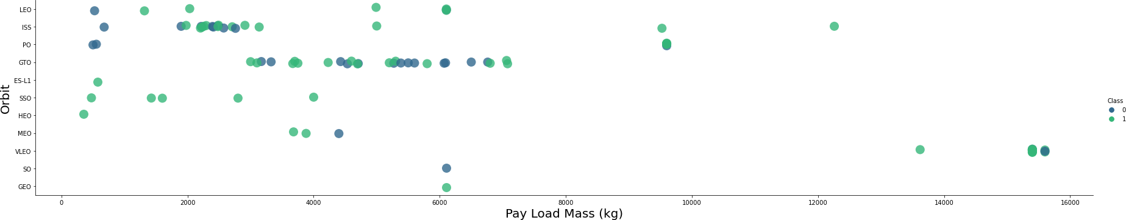
Payload vs. Orbit Type
Show a scatter point of payload vs. orbit type
Show the screenshot of the scatter plot with explanations
Green indicates successful launch; Purple indicates unsuccessful launch.
Payload mass seems to correlate with orbit
LEO and SSO seem to have relatively low payload mass
The other most successful orbit VLEO only has payload mass values in the higher end of the range

Slide 23
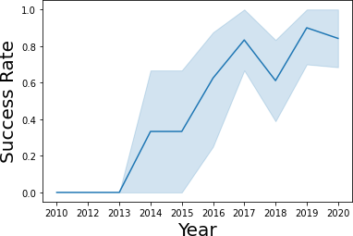
Launch Success Yearly Trend
Show a line chart of yearly average success rate
Show the screenshot of the scatter plot with explanations
Success generally increases over time since 2013 with a slight dip in 2018
Success in recent years at around 80%
95% confidence interval (light blue shading)

Slide 24
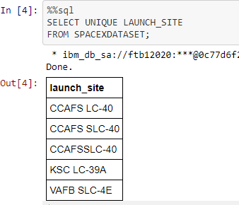
All Launch Site Names
Find the names of the unique launch sites
Present your query result with a short explanation here
Query unique launch site names from database.
CCAFS SLC-40 and CCAFSSLC-40 likely all represent the same
launch site with data entry errors.
CCAFS LC-40 was the previous name. Likely only 3 unique launch_site values: CCAFS SLC-40, KSC LC-39A, VAFB SLC-4E

Slide 25

Launch Site Names Begin with 'CCA'
Find 5 records where launch sites begin with `CCA`
Present your query result with a short explanation here

Slide 26

Total Payload Mass
Calculate the total payload carried by boosters from NASA
Present your query result with a short explanation here

Slide 27
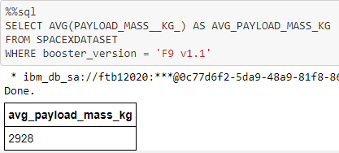
Average Payload Mass by F9 v1.1
Calculate the average payload mass carried by booster version F9 v1.1
Present your query result with a short explanation here

Slide 28

First Successful Ground Landing Date
Find the dates of the first successful landing outcome on ground pad
Present your query result with a short explanation here

Slide 29

Successful Drone Ship Landing with Payload between 4000 and 6000
List the names of boosters which have successfully landed on drone ship and had payload mass greater than 4000 but less than 6000
Present your query result with a short explanation here

Slide 30
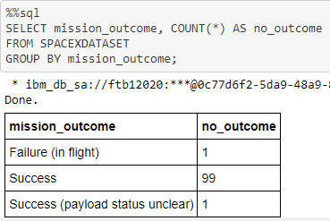
Total Number of Successful and Failure Mission Outcomes
Calculate the total number of successful and failure mission outcomes
Present your query result with a short explanation here

Slide 31
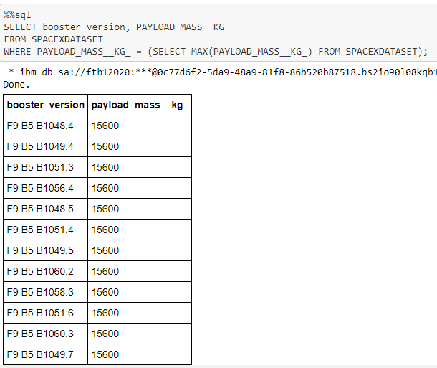
Boosters Carried Maximum Payload
List the names of the booster which have carried the maximum payload mass
Present your query result with a short explanation here

Slide 32
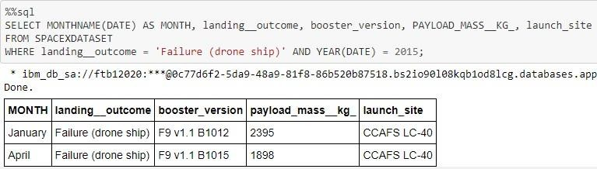
2015 Launch Records
List the failed landing_outcomes in drone ship, their booster versions, and launch site names for in year 2015
Present your query result with a short explanation here

Slide 33
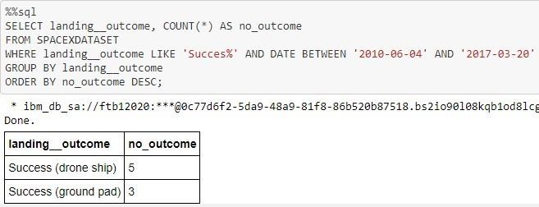
Rank Landing Outcomes Between 2010-06-04 and 2017-03-20
Rank the count of landing outcomes (such as Failure (drone ship) or Success (ground pad)) between the date 2010-06-04 and 2017-03-20, in descending order
Present your query result with a short explanation here

Slide 34

Section 3

Slide 35

Launch Site Locations
The left map shows all launch sites relative US map. The right map shows the two Florida launch sites since they are very close to each other. All launch sites are near the ocean.

Slide 36

Color-Coded Launch Markers
Clusters on Folium map can be clicked on to display each successful landing (green icon) and failed
landing (red icon). In this example VAFB SLC-4E shows 4 successful landings and 6 failed landings.

Slide 37



Key Location Proximities
Using KSC LC-39A as an example, launch sites are very close to railways for large part and supply transportation. Launch sites are close to highways for human and supply transport. Launch sites are also close to coasts and relatively far from cities so that launch failures can land in the sea to avoid rockets falling on densely populated areas.

Slide 38

Section 4

Slide 39
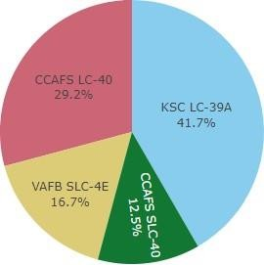
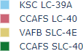
Successful Launches Across Launch Sites
This is the distribution of successful landings across all launch sites. CCAFS LC-40 is the old name of CCAFS SLC-40 so CCAFS and KSC have the same amount of successful landings, but a majority of the successful landings where performed before the name change. VAFB has the smallest share of successful landings. This may be due to smaller sample and increase in difficulty of launching in the west coast.

Slide 40

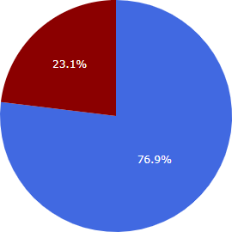
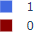
Highest Success Rate Launch Site
KSC LC-39A has the highest success rate with 10 successful landings and 3 failed landings.

Slide 41

Payload Mass vs. Success vs. Booster Version Category
Plotly dashboard has a Payload range selector. However, this is set from 0-10000 instead of the max Payload of 15600. Class indicates 1 for successful landing and 0 for failure. Scatter plot also accounts for booster version category in color and number of launches in point size. In this particular range of 0-6000, interestingly there are two failed landings with payloads of zero kg.

Slide 42

Section 5

Slide 43
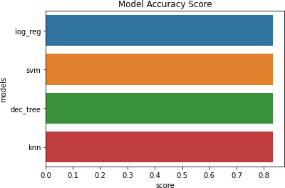
Classification Accuracy
Visualize the built model accuracy for all built classification models, in a bar chart
Find which model has the highest classification accuracy

Slide 44

Confusion Matrix
Show the confusion matrix of the best performing model with an explanation
Since all models performed the same for the test set, the confusion matrix is the same across all models. The models predicted 12 successful landings when the true label was successful landing.
The models predicted 3 unsuccessful landings when the true label was unsuccessful landing.
The models predicted 3 successful landings when the true label was unsuccessful landings (false positives). Our models over predict successful landings.
Correct predictions are on a diagonal from top left to bottom right.

Slide 45
Conclusions
Our task: to develop a machine learning model for Space Y who wants to bid against SpaceX
The goal of model is to predict when Stage 1 will successfully land to save ~$100 million USD
Used data from a public SpaceX API and web scraping SpaceX Wikipedia page
Created data labels and stored data into a DB2 SQL database
Created a dashboard for visualization
We created a machine learning model with an accuracy of 83%
Allon Mask of SpaceY can use this model to predict with relatively high accuracy whether a launch will have a successful Stage 1 landing before launch to determine whether the launch should be made or not
If possible more data should be collected to better determine the best machine learning model and improve accuracy

Slide 46
Appendix
Include any relevant assets like Python code snippets, SQL queries, charts, Notebook outputs, or data sets that you may have created during this project
GitHub repository url:
https://github.com/Balasubramanian1981/Dheesha/
Special Thanks to All Instructors
https://www.coursera.org/professional-certificates/ibm-data-science?#instructors

Slide 47


